Slide 1
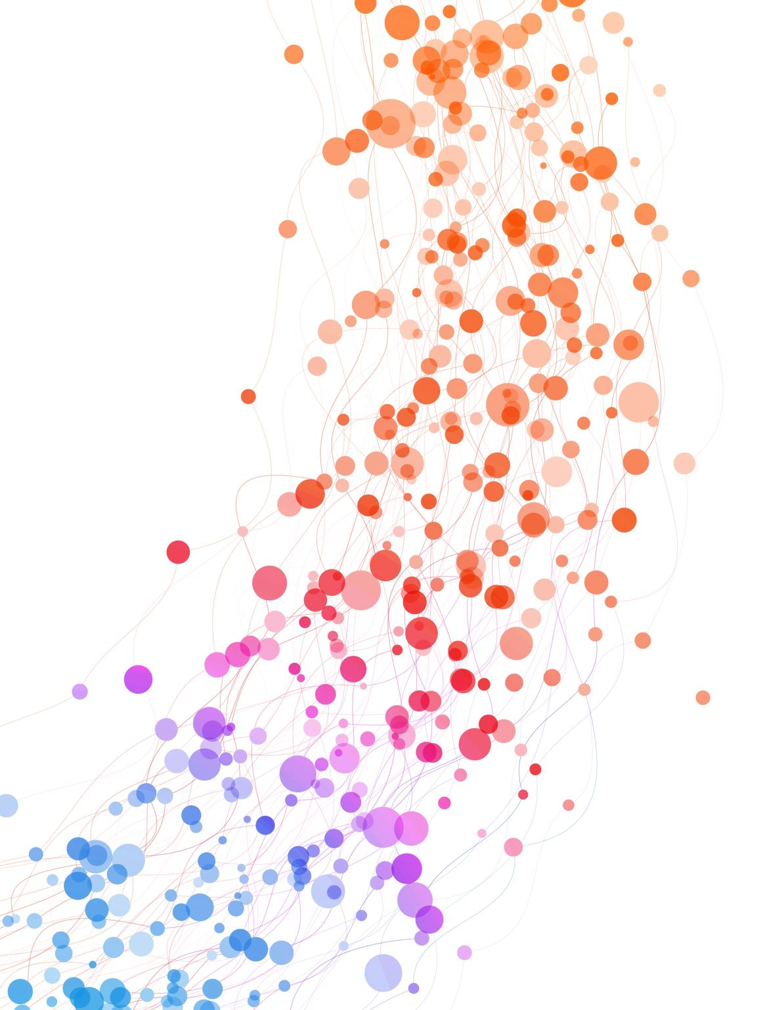
Naïve Bayesian Classifier

Slide 2
Naïve Bayes Classifier
probabilistic machine learning model based on Bayes' Theorem
used for classification tasks.
It assumes that all the features used for prediction are independent.
Supervised Learning Algorithm

Slide 3
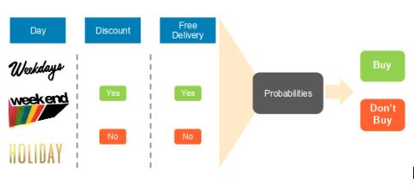
Shopping Example

Slide 4
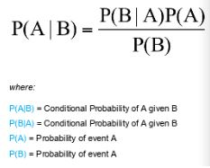
Bayes Theorem

Slide 5
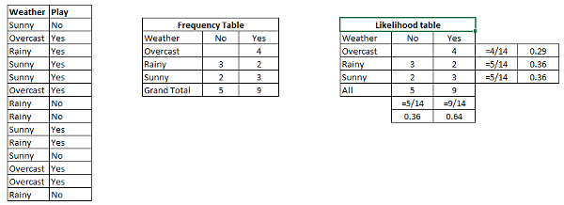
Working of Algorithm
Create a Likelihood table by finding the probabilities

Slide 6
Applications of naïve bayes
Spam Filtering
Document Classification
Sentiment Analysis
Mental State Prediction
Real-Time Prediction
Multi-class Prediction
Text Classification
Recommendation

Slide 7
Types of Naïve Bayes
Gaussian Naïve Bayes: Assumes Features & values are in Gaussian Distribution
Multinomial Naïve Bayes: It is used in discrete counts
Bernoulli Naïve Bayes: The binomial model is useful if your feature vectors are boolean (i.e. zeros and ones).
Categorical Naïve Bayes: Useful if the features are categorically distributed

Slide 8
Pro’s & Con’s
It is easy and fast to predict the class of test data set. It also performs well in multi-class prediction
When the assumption of independence holds, the classifier performs better than other machine learning models, requiring less training data.
It perform well in case of categorical input variables compared to numerical variable(s). For numerical variable, normal distribution is assumed
Zero Frequency Problem: Feature present in Test data but not available in Training data
Naïve Bayes is also known as a bad estimator, so the probability outputs from predict_proba should not be taken too seriously.

